Slide 1


Leadership Pathway Trainer Orientation
Leader Track

Slide 2

Orientation
Welcome & Sign-In
Check the chat and use sheet to enter Name, Email, and one word about what you’re bringing to this orientation. ITEs indicate willingness to onboard other IT/ITEs. Receive a Guide Trainer app.
Honest and Open Approach to Orientation. We are all ITs and ITEs. This is not a training but a familiarization to courses and curriculum.
This is New. We have not run these courses but we’ve done this before.
Singing from the same song sheet. This session is not about “Me” but about “Us” as an organization, getting on the same page.
Ground Rules. Raise your electronic hand. Speak from the heart, and get to the heart of the matter.
Orientation Flow. Shift in Approach, Course Elements & Flow, Resources and Breakout Session.
Notes:
Welcome & Housekeeping, Introduce Yourself, Jake and Tara.

Slide 3
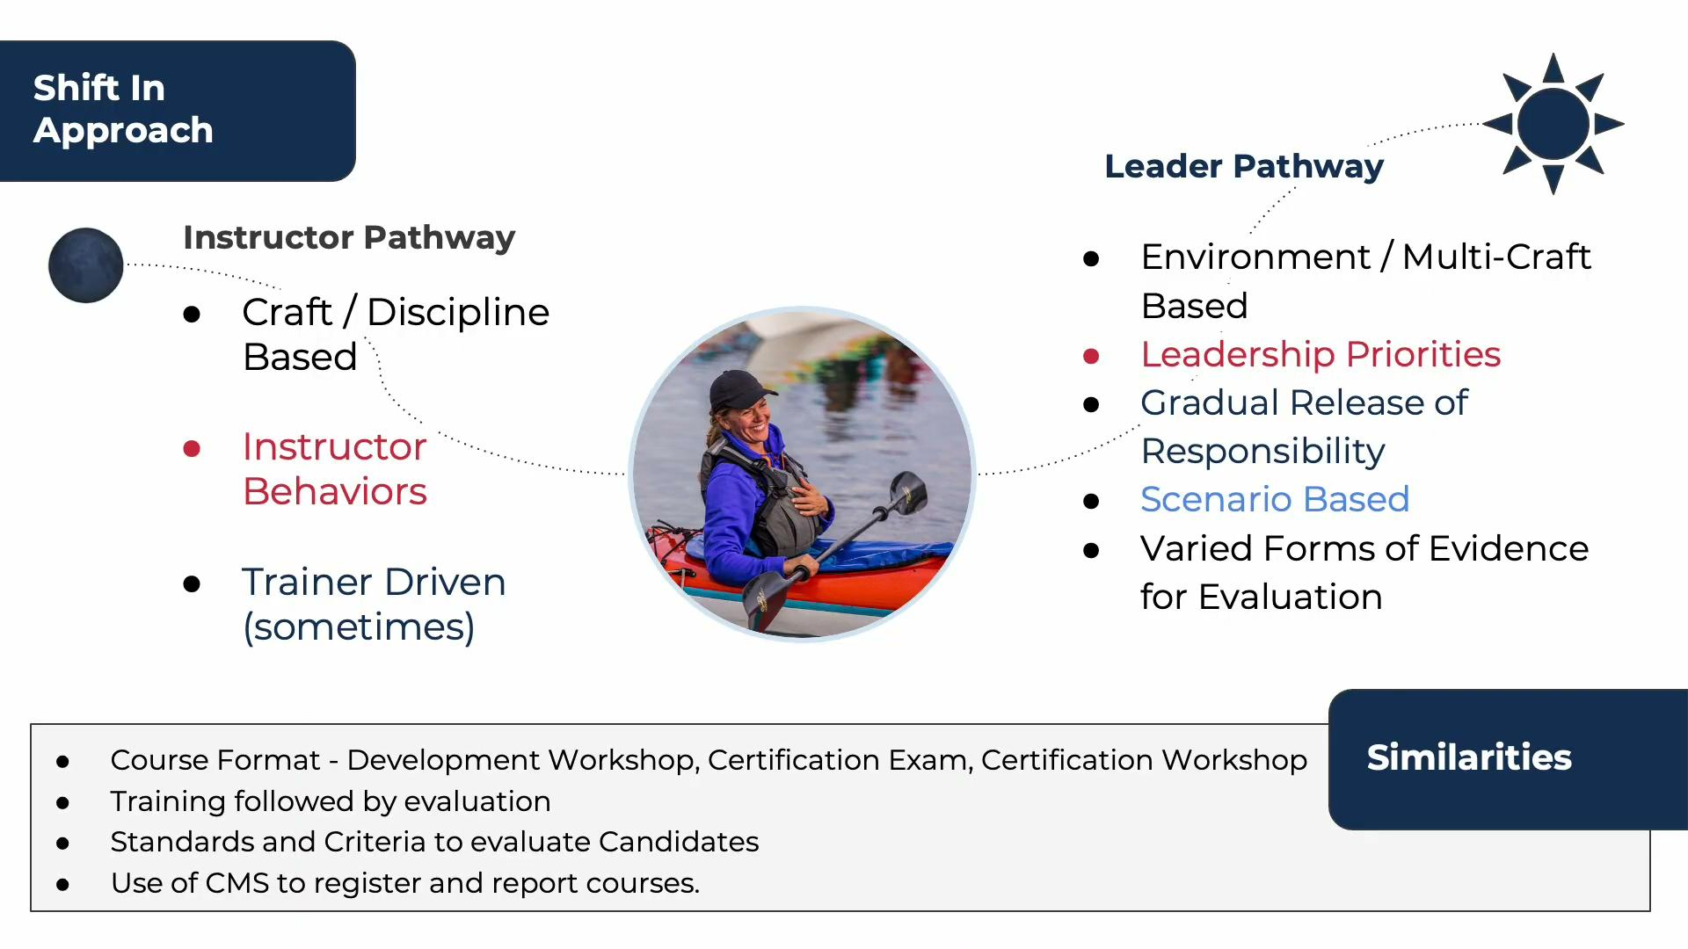
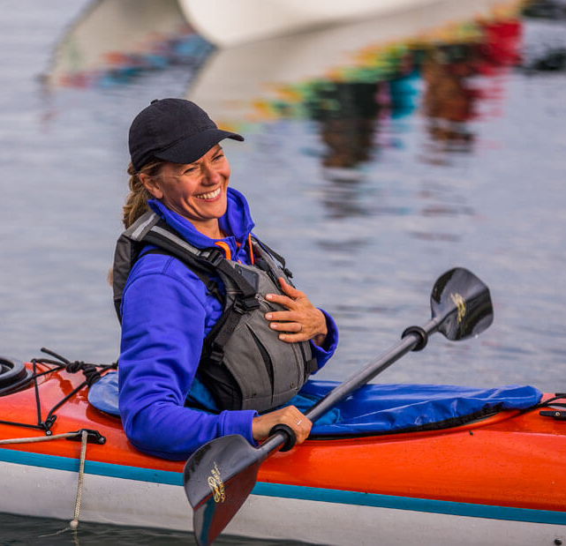
Shift In Approach
Leader Pathway
🌑
Environment / Multi-Craft Based
Leadership Priorities
Gradual Release of Responsibility
Scenario Based
Varied Forms of Evidence for Evaluation
Instructor Pathway
Craft / Discipline Based
Instructor Behaviors
Trainer Driven (sometimes)
Similarities
Course Format - Development Workshop, Certification Exam, Certification Workshop
Training followed by evaluation
Standards and Criteria to evaluate Candidates
Use of CMS to register and report courses.
Notes:
The new Leader Pathway is positioned alongside the ACA's longstanding and internationally recognized Instructor Certification Program. It does not replace the Instructor Pathway; rather, it offers an alternative certification tailored to trip leaders and guides worldwide.
Requested by the community for many years, this new certification pathway shifts from a siloed, discipline-specific approach to a more versatile, environment-based framework.
A complementary curriculum prioritizes leadership competencies, distinguishing it from the Instructor Pathway's focus on teaching methodologies and instructional behaviors.
This curriculum incorporates an intentional and gradual release of responsibility from trainer to candidate, utilizing scenario-based learning and diverse forms of evidence throughout the training process.
As trainers and educators, you will find familiarity in the program’s structure, which mirrors existing course formats, including the Leader Development Workshop, Certification Exams, and Certification Workshop. The pathway follows a consistent model of training, evaluation, standards, and criteria, with course registration and reporting managed through the CMS.

Slide 4
Shift In Approach
Leader Pathway
🌑
Environment / Multi-Craft Based
Leadership Priorities
Gradual Release of Responsibility
Scenario Based
Varied Forms of Evidence for Evaluation
Instructor Pathway
Craft / Discipline Based
Instructor Behaviors
Trainer Driven (sometimes)
Similarities
Course Format - Development Workshop, Certification Exam, Certification Workshop
Training followed by evaluation
Standards and Criteria to evaluate Candidates
Use of CMS to register and report courses.
Notes:
The new Leader Pathway is positioned alongside the ACA's longstanding and internationally recognized Instructor Certification Program. It does not replace the Instructor Pathway; rather, it offers an alternative certification tailored to trip leaders and guides worldwide.
Requested by the community for many years, this new certification pathway shifts from a siloed, discipline-specific approach to a more versatile, environment-based framework.
A complementary curriculum prioritizes leadership competencies, distinguishing it from the Instructor Pathway's focus on teaching methodologies and instructional behaviors.
This curriculum incorporates an intentional and gradual release of responsibility from trainer to candidate, utilizing scenario-based learning and diverse forms of evidence throughout the training process.
As trainers and educators, you will find familiarity in the program’s structure, which mirrors existing course formats, including the Leader Development Workshop, Certification Exams, and Certification Workshop. The pathway follows a consistent model of training, evaluation, standards, and criteria, with course registration and reporting managed through the CMS.

Slide 5
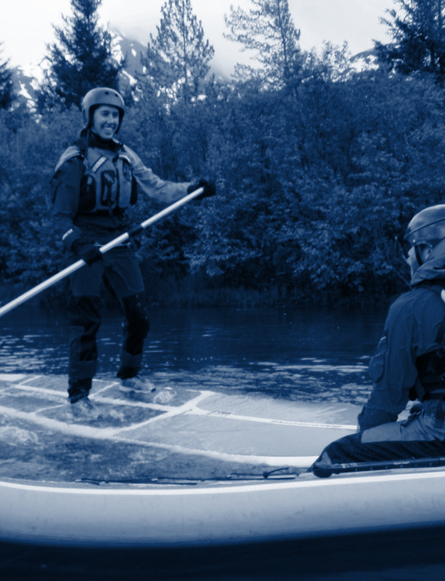
Operating Conditions
Trainers shall choose, and subsequent trips led by certified Leaders, a location that offers calm and protected waters with constant access to landing areas. The trainer shall keep the participants within the parameters of 0.25 nautical miles (~500m / ~0.3 miles) of shore during the course. Conditions during the assessment shall be: Winds less than 10 knots, waves less than 1 foot, shore break less than 1 foot, rapids no exceeding Class I (or) tidal current not exceeding 1 knot.
Skills Award Prerequisites
L1 or L2 Skills Award - any discipline.
Trainer - CPL Trainer or Educator
Multi Craft Component
The multi-craft component to this course focuses on rescues of different craft in calm and protected waters.. The candidate must demonstrate their ability to handle their craft in their this environment and be able to rescue other types of boaters.
Community
Paddlesports
Leader
Environment
Notes:
Today, we are focusing on the Leader Pathway’s "Leader Track," designed for those leading day trips. An orientation for the new multi-day and wilderness "Guide Track" will be available in the coming months.
The Leader Track comprises five courses, starting with the foundational Community Paddlesports Leader (CPL) certification, which has been restructured to be more marketable and versatile. Key updates include a reduced number of prerequisite courses and an expanded operating environment for both the course and certification.
The operating environment now encompasses most "Level 2" conditions, aligning closely with the environments in the existing Level 2 Coastal Kayak Trip Leader Assessment and River Day Trip Leader assessments
Candidates need either a Level 1 or Level 2 Skills Award in any discipline to participate. The new course provider title is "CPL Leader Trainer" or "CPL Leader Trainer Educator."
The revised CPL course retains its multi-craft component. Candidates must demonstrate proficiency in handling their craft in the course environment and performing rescues for other types of boaters.

Slide 6
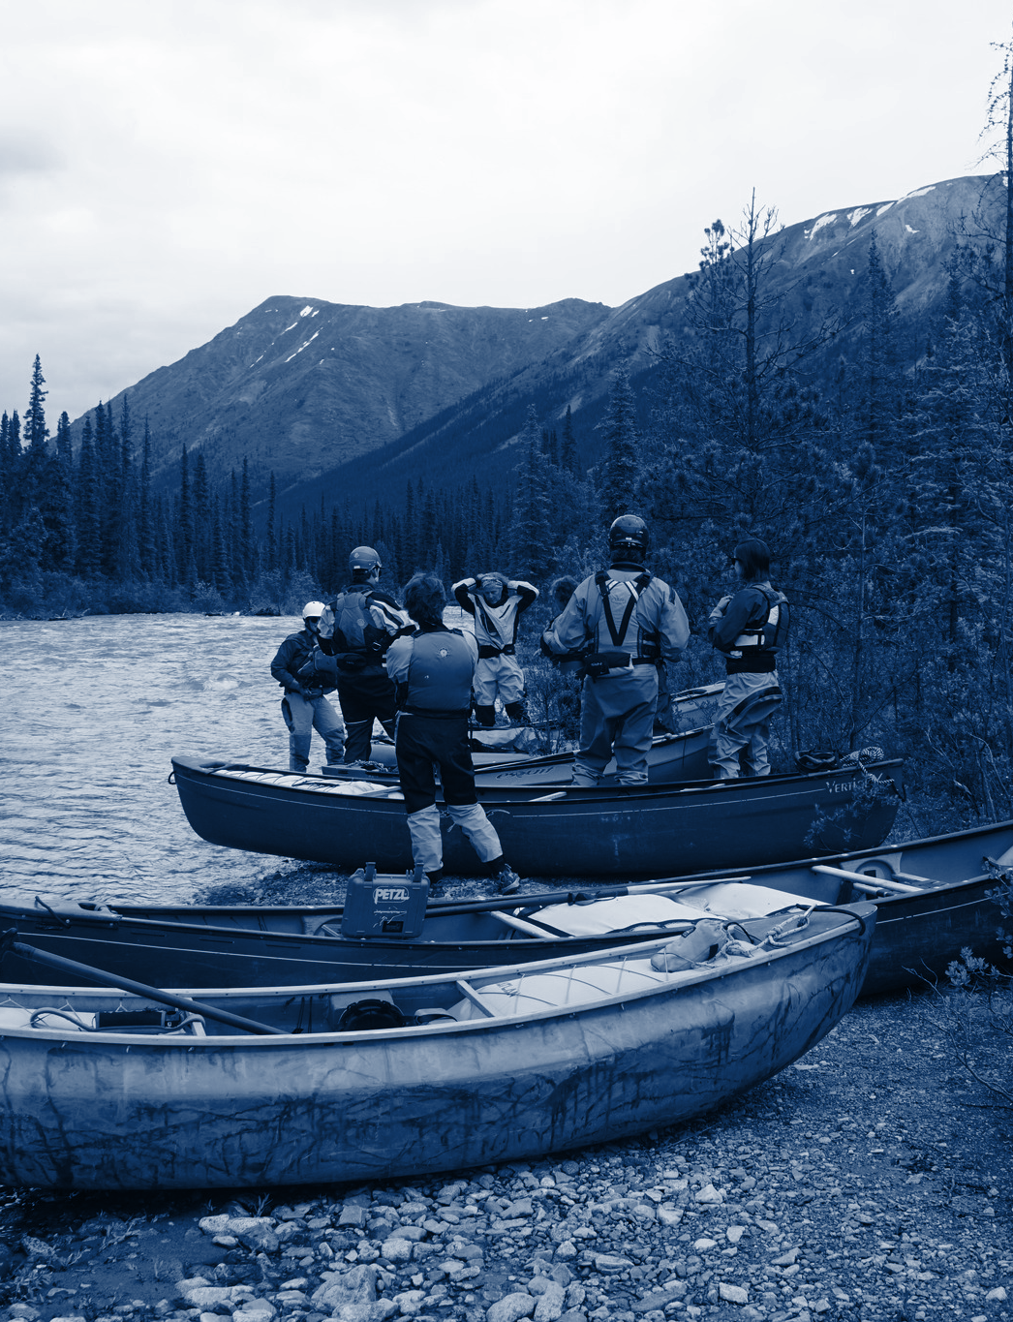
Operating Conditions
River Leader Trainers will choose an appropriate location with moving water on rivers that includes class I-II sections. A rapid class includes rapids at the lower and upper ends
of the difficulty range, designated “-“ and “+” respectively. The rivers are to be accessible and have access to portages.
Skills Award Prerequisites
L2 or L3 Skills Award - River Kayak, SOT River Kayaking, SUP, River Canoeing, Paddle Rafting, Oar Rafting, River Packrafting
L2 Essentials of River Safety and Rescue Skills Award
Trainer - River Leader Trainer or Educator
Multi Craft Component
The multi-craft component to this course focuses on rescues of different craft in Class II whitewater. The candidate must demonstrate their ability to handle their craft in this environment and be able to rescue other types of boaters.
Paddlesport Leader
River Leader
Environment
Notes:
The next level of certification is Paddlesports Leader, which is divided into two distinct courses: River Leader and Coastal Leader.
The River Leader course is designed for those aiming to lead on rivers with Class I-II sections. Candidates must hold a Level 2 or Level 3 Skills Award in any ACA river discipline and an Essentials of River Safety and Rescue Skills Award.
Trainers for this course hold the River Leader Trainer or River LeaderTrainer Educator certification. The course incorporates a multi-craft component, emphasizing the rescue of other craft in Class II whitewater conditions.

Slide 7
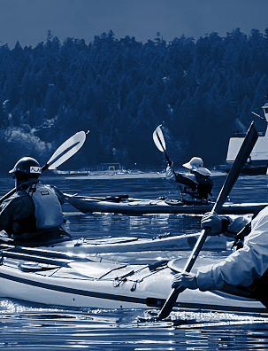
Operating Conditions
Coastal Leader Trainers will choose a location on lakes or coastal waters with some exposure to wind and wave conditions, with regular access to landing areas and within
1.5 nautical miles from shore: Participants must be observed in 3 of 4 of the following conditions during the exam: Winds 8-12 knots, Waves 1-2 feet, Surf 1-2 feet, Current 1-2 Knots.
Skills Award Prerequisites
L2 or L3 Skills Award - Coastal Kayak, Canoe, SUP or Surf Ski disciplines
Trainer - Coastal Leader Trainer or Educator
Multi Craft Component
The multi-craft component to this course focuses on rescues of different craft in venues with some exposure to conditions. Candidates must demonstrate the ability to handle their craft, and rescue other types of craft in these conditions.
Paddlesport Leader
Coastal Leader
Environment
Notes:
The Coastal Leader certification is designed for individuals intending to lead groups on lakes and coastal waters. While its operating environment aligns with the former Level 3 Coastal Kayak Trip Leader Assessment, the new course expands certification to include stand-up paddleboard (SUP) and canoe leaders, in addition to sea kayak leaders.
Delivered by Coastal Leader Trainers or Coastal Leader Trainer Educators, the course adopts a multi-craft approach. Candidates must demonstrate personal proficiency in their chosen craft and the ability to rescue other types of craft within the course’s operating environment. This certification enables leaders to guide diverse groups on lakes and coastal waters, enhancing their professional versatility.

Slide 8
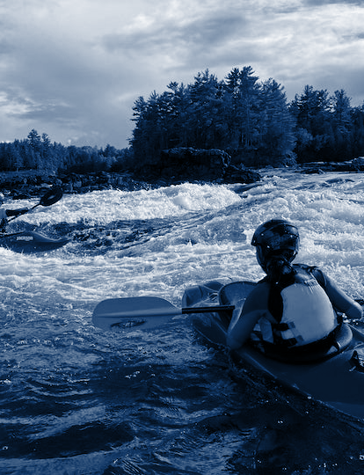
Operating Conditions
Advanced River Leader Trainers shall choose an appropriate location with moving water on rivers that include class III–IV sections. A rapid class includes rapids at the lower and upper ends of the difficulty range, designated “-“ and “+” respectively. The rivers are to be accessible and have access to portages.
Skills Award Prerequisites
L3, L4, or L5 Skills Award - River Kayaking, River Canoeing, Paddle Rafting, Oar Rafting, or River Packrafting.
L4 Swiftwater Rescue Skills Award (or higher)
Trainer - Advanced River Leader Trainer or Educator
Multi Craft Component
The multi-craft component to this course focuses on rescues of different craft in Class III-IV whitewater. The candidate must demonstrate their ability to handle their craft this environment and be able to rescue other types of boaters.
Adv. Paddlesport Leader
Advanced
River Leader
Environment
Notes:
Advanced Paddlesport Leader certifications equip paddlers to lead groups in demanding environments. Offered in two distinct courses—Advanced River Leader and Advanced Coastal Leader—these certifications establish a high standard for leadership in challenging waters.
The Advanced River Leader certification prepares paddlers to lead in Class III-IV whitewater environments. Candidates are trained and assessed on leading various whitewater craft, with a strong emphasis on non-craft-specific swiftwater rescue techniques.

Slide 9
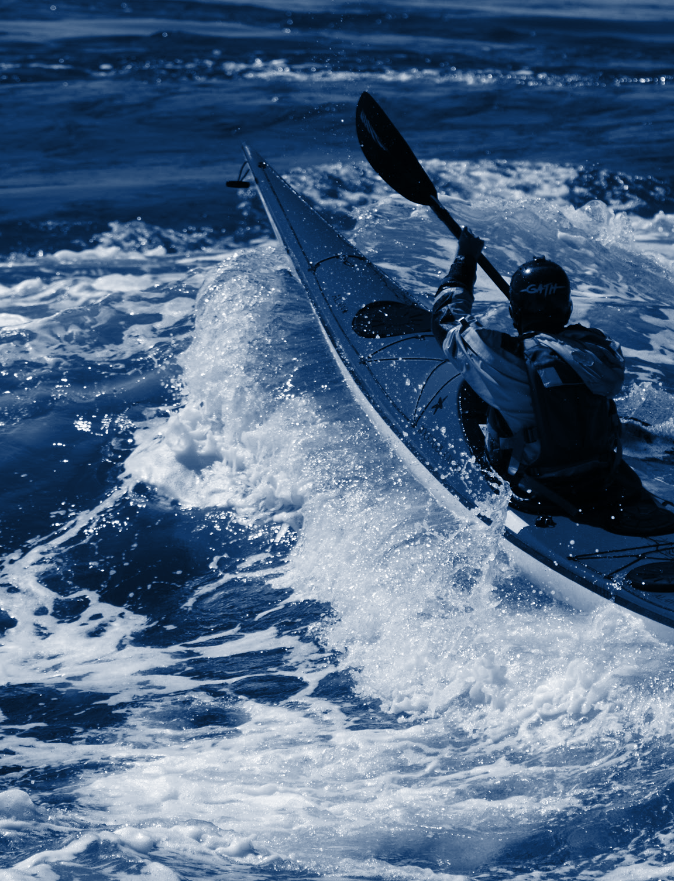
Operating Conditions
Advanced Coastal Leader Trainers shall choose a location on large lakes or coastal waters with some exposure to wind and wave conditions, with regular access to landing areas and within 2 nautical miles from shore: Participants must be observed in 3 of 4 of the following conditions during the exam. Winds 14-20 knots, Waves 2-4 feet, Surf 2-4 Feet & Tidal Current 2-4 knots.
Skills Award Prerequisites
Coastal Kayak L3, L4, or L5 Skills Award
Trainer - Advanced Coastal Leader Trainer or Educator
Multi Craft Component
The multi-craft component of this course is limited to the environment of the Coastal Leader course as candidates would be certified to lead multi-craft groups in lesser conditions. Trainers must facilitate a multi-craft rescue session in Coastal Leader conditions while also allowing candidates to demonstrate paddling and rescue ability in sea kayaks.
Adv. Paddlesport Leader
Advanced
Coastal Leader
Environment
Notes:
The Advanced Coastal Leader certification equips sea kayakers to lead groups on exposed coastlines and in open-water conditions. Delivered by Advanced Coastal Leader Trainers or Educators, the course focuses on evaluating leadership priorities and skills in advanced coastal environments, including the ability to rescue other craft types in less demanding conditions.

Slide 10

Environment, Skills Awards & Adjustments
Skills Award Prerequisites | Operating Environment
Establishes baseline competency for participating in course. | The venue and conditions for learning and testing during the course. The environment that leaders can operate in once certified.
Location/Course Considerations | Multi-Craft & Risk Management
Trainers to ensure venues correlate to course descriptions. Train to the standard, assess to the objective. | Minimum of one other craft is required. Emphasize judgement and decision making in courses.
Notes:
With a new program come new language and expectations. All courses incorporate Skills Awards, previously known as Skills Assessments, as prerequisites for participation at every level. As highlighted in previous slides, each course accepts multiple levels of Skills Awards to qualify candidates, broadening participation while establishing baseline competency.
With this baseline, trainers can confidently deliver courses within the prescribed operating environment. Each course’s operating environment corresponds to the conditions in which candidates will be certified to lead. Trainers must ensure their chosen venue aligns with the course description, training to the standard and assessing to the objective.
For all Leader Pathway courses, candidates must demonstrate proficiency in handling their own craft within the operating environment and the ability to manage rescues for at least one other craft type.

Slide 11
Leadership Priorities
People - Equipping and empowering yourself and others to produce the best trip possible and to create a safe and thoughtful environment.
Practices - Creating effective plans, cultivating effective communication skills, and developing the practices to respond to situations in an effective manner.
Place - Understanding your environment and how your plan, equipment, people interact with it.
Purpose - Connecting with a sense of integrity with your practice while cultivating community and the values of the ACA.
People
4 P’s of Paddlesports Leadership
Places
Practices
Purpose
Notes:
The 4P’s of Paddlesports establish a comprehensive leadership framework for the ACA’s Leader Pathway. This holistic model, adaptable for use alone or alongside other leadership models, equips trainers to meet diverse organizational needs. All workshops must incorporate the 4P’s, with trainers encouraged to supplement with additional content as needed to ensure consistent leadership training.

Slide 12

Phase 1
Building a Foundation
Gradual Release of Responsibility
Phase 1
Building a Foundation
The experience asks you to begin by learning, practicing and experiencing as your trainer models, explains, instructs, and guides you through the basics.
Your trainer will model leadership, explaining the ‘why’ and ‘how’, and training specific skills and knowledge while the candidates are experiencing leadership, practicing skills and knowledge, and learning. Providing an example of leadership, you’ll have the opportunity to explore how to put this into practice.
Gradual Release
Phase 3
Performing as a leader
Phase 2
Stepping into leadership
Notes:
The Gradual Release of Responsibility model, a proven framework used by many ACA Trainers, guides Leader candidates through a clear, structured progression. Explicitly integrated into training and exams, it is critical for candidates to know where they are in the learning and evaluation process —learning, demonstrating, or performing—fostering confidence and clarity in their development as they
Build a foundation
Step into Leadership and
Perform as a leader

Slide 13
Phase 1
Building a Foundation
Gradual Release of Responsibility
Phase 1
Building a Foundation
The experience asks you to begin by learning, practicing and experiencing as your trainer models, explains, instructs, and guides you through the basics.
Your trainer will model leadership, explaining the ‘why’ and ‘how’, and training specific skills and knowledge while the candidates are experiencing leadership, practicing skills and knowledge, and learning. Providing an example of leadership, you’ll have the opportunity to explore how to put this into practice.
Gradual Release
Phase 3
Performing as a leader
Phase 2
Stepping into leadership
Notes:
In Phase 1, candidates build foundational skills through guided learning. Trainers model leadership priorities, demonstrating the “why” and “how” of effective leadership while teaching specific skills and knowledge. Candidates actively practice these skills, engage in leadership experiences, and explore practical applications under close trainer guidance within the course’s operating environment.

Slide 14
Phase 2
Stepping into leadership
Gradual Release of Responsibility
Phase 2
Stepping into leadership
Then you’ll transition into a phase in which you experiment and practice leading. You’ll also discourse about your reasoning for your decisions and spend time assessing yourself and your decisions.
In this phase, your trainer acts more as a facilitator, assisting you based on your needs and helping provide feedback and space for reflection. You’ll be able to practice with guidance and support from your trainer.
Gradual Release
Phase 1
Building a Foundation
Phase 3
Performing as a leader
Notes:
In Phase 2, candidates transition to practicing leadership with guidance. They experiment with leading groups, reflect on their decision-making, and assess their performance. Trainers act as facilitators, providing tailored feedback and fostering reflection to support candidates in refining their leadership skills within the course’s operating environment.

Slide 15
Phase 3
Performing as a leader
Gradual Release of Responsibility
Phase 3
Performing as a leader
In the final stages of the course, you will conduct leadership exercises with little guidance from your trainer. You’ll perform your skills, knowledge, and leadership abilities. Your trainer will observe as they evaluate and assess your performance.
Gradual Release
Phase 1
Building a Foundation
Phase 2
Stepping into leadership
Notes:
In Phase 3, candidates demonstrate independent leadership with minimal trainer guidance. They apply their skills, knowledge, and leadership abilities in practical exercises within the course’s operating environment. Trainers observe and evaluate performance, assessing candidates’ readiness to lead effectively in their certified conditions.

Slide 16
Types of Evidence / Course Elements
Course Type | Written Exam | Trip Plan | Scenarios (Case Studies & Practical) | Briefings & Reflection | Practical Trip Leading / Guiding | Equipment Prep & Use | Personal Prep | Oral Exam | Camping
Community Paddlesports Leader | ✓ | ✓ | ✓ | ✓ | ✓ | ✓ | ✓ | 🆇 | 🆇
Paddlesports Leader River Leader Coastal Leader | ✓ | ✓ | ✓ | ✓ | ✓ | ✓ | ✓ | 🆇 | 🆇
Advanced Paddlesports Leader Adv. River Leader Adv. Coastal Leader | ✓ | ✓ | ✓ | ✓ | ✓ | ✓ | ✓ | 🆇 | 🆇
Paddlesport Guide Coastal Guide River Guide | ✓ | ✓ | ✓ | ✓ | ✓ | ✓ | ✓ | ✓ | ✓
Advanced Paddlesports Guide Adv. Coastal Guide Adv. River Guide | ✓ | ✓ | ✓ | ✓ | ✓ | ✓ | ✓ | ✓ | ✓
Notes:
Trainers utilize diverse evidence forms to evaluate Leader Pathway candidates, guided by the trainers course workbook’s exam protocols to ensure a consistent evaluation environment. Leader Track courses require a written exam, trip plan development, briefings, and practical trip-leading reflection and evaluation. Guide Track courses also include an oral exam and camping assessments.

Slide 17

Types of Evidence
How they are incorporated in the curriculum
Written Exam
Trip Plan
Scenarios
Briefings & Reflections
Practical Trip Leading
Personal Prep
Equipment Prep & Use
Additional Exam Elements for Guides
Oral Exam
Camping
Notes:
Written Exam - occurs either at start or end of Leader exam (overall score and section score)
Trip Plan - prepare trip plan to submit during exam; may be scenario or use of actual location
Scenarios - used during training course and during exam; guidance provided on specifics (i.e. 1 simple and 1 complex)
Briefings & Reflections - guidance provided on specifics (i.e. 2 briefings & 2 reflections) for demonstrating knowledge, awareness, communication, etc.
Practical Trip Leading - demonstrating leadership, communication, decision-making, etc. for period of time that includes scenarios, briefings, etc.
Personal Prep - provide an explanation of what they prepared and how they organized it.
Equipment prep & use - observation, explanation, and questioning specific to organization and use of paddling equipment; includes a repair scenario
Oral Exam - occurs during exam with preference for evening during camping; guidance provided for types of question and flow (overall score and section score)
Camping - personal skills and managing campsites

Slide 18


ACA Leadership Pathway
ACA Leadership Pathway
Course Elements

Slide 19
Course Elements
Suggested Course Flow (based on Paddlesport Leader)
On land
5
REFLECT
Engage participants in what they have learned so far and taken away from the experience.
On water
On water
5
Skills Training / Risk and Response
Rescues and more challenging paddling skills that are scenario-based
Simulated Trip
The trainer takes candidates on a brief simulated outing, including a briefing, embarking, organizing the group on the water towards a destination. The trainer also uses this time to assess candidate personal skills and provide basic training
2
Leadership Overview
Discussion based introduction on two sections/modules:
- ACA Leadership Model - 4 Ps.
- PURPOSE - Values.
3
Warm-up: Spark Agency and Engagement
Utilize an on-land warm up activity as a conduit for self-assessment, awareness of others, and dialogue, collaboration, an critical thinking
On land
1
On land
PLACE: Environment Workshop
Overview and discussion of assessing your environment.
4
Welcome and Introduction
Paperwork, logistics, introductions. Clearly presenting the Paddler-Centered learning approach and how the program structure/learning supports that. Theory and discussion, practice, reflection. Overview of exam portion.
0
Notes:
New offering
On water
Multi-craft
Show from their craft of choice, that they can rescue other crafts.
That they can lead and rescue in a flat water environment
Big thing: goes across discipline.
Focuses on leadership.
Display that you can create fun paddling environments
Speaks directly to the demands of people in gov’t. Before it was restricting and a jump previously.
They will be even less technically engaged (sign ups need to be easy)
They need to be valued as much as instructor in its own right
Paddlesport Safety Cert—-> Group Leader —> Day Trip/Longer Trip
Mentorship track for future leaders
How does trip leader content engage with instructor path?
LZ: Updating the curriculum consistently. Each time they are updating, there is more value. Gaps that need to be filled.
AL: Updates are about providing updates to our users vs just updating it to update it. As a discipline, continually add value for end users.
Mindset shift - value we provide, vs politics. More value with award.
Or customers - entities that the programs are for.

Slide 20
Course Elements
Suggested Course Flow (based on Paddlesport Leader)
On water
PEOPLE:
Rescues in Practice
Candidates conduct a “mock rescue exercise” in charge of handling a specific emergency situation.
10
On water
PEOPLE:
Leadership in Practice
Candidates conduct a ‘mock leadership exercise’ in charge of group with specific tasks/objectives.
7
On land
PLANNING:
Equipment And Environment Workshop
Developing an approach to equipment, shore based repairs, on-water repairs. Leave-no-trace and environmental stewardship.
11
REFLECT
Engage participants in what they have learned from this high impact day and process their thoughts.
9
On land
6
PLANNING:
Trip planning workshop.
Overview on planning an agenda and packing.
On land
PEOPLE:
Decision-making workshop
Candidates learn and discuss a framework for decision making (Thinking Fast and Thinking Slow)
8
Notes:
New offering
On water
Multi-craft
Show from their craft of choice, that they can rescue other crafts.
That they can lead and rescue in a flat water environment
Big thing: goes across discipline.
Focuses on leadership.
Display that you can create fun paddling environments
Speaks directly to the demands of people in gov’t. Before it was restricting and a jump previously.
They will be even less technically engaged (sign ups need to be easy)
They need to be valued as much as instructor in its own right
Paddlesport Safety Cert—-> Group Leader —> Day Trip/Longer Trip
Mentorship track for future leaders
How does trip leader content engage with instructor path?
LZ: Updating the curriculum consistently. Each time they are updating, there is more value. Gaps that need to be filled.
AL: Updates are about providing updates to our users vs just updating it to update it. As a discipline, continually add value for end users.
Mindset shift - value we provide, vs politics. More value with award.
Or customers - entities that the programs are for.

Slide 21
Course Elements
Suggested Course Flow (based on Paddlesport Leader)
On water
16
EXAM
Scenario 3 - Rescue
TBD
Wrap-up
Program Reflections, Celebrations, Next Steps
A moment to reflect on the program as a whole, feedback mechanism, logistics and next steps, LNT and logistics for leaving/getting back home.
13
Exam Prep and Launch
Candidates conduct an exercise to prepare, communicate and launch participants.
18
On land
On land
15
EXAM
Scenario 2: Group Scenario
TBD
12
Exam Preparation
Provide participants with an overview and logistics for the exam.
17
Exam Reflection
Engage participants in what they have learned from their exam.
14
EXAM
Scenario 1: Paddling and Maneuvering a Group
TBD
Notes:
New offering
On water
Multi-craft
Show from their craft of choice, that they can rescue other crafts.
That they can lead and rescue in a flat water environment
Big thing: goes across discipline.
Focuses on leadership.
Display that you can create fun paddling environments
Speaks directly to the demands of people in gov’t. Before it was restricting and a jump previously.
They will be even less technically engaged (sign ups need to be easy)
They need to be valued as much as instructor in its own right
Paddlesport Safety Cert—-> Group Leader —> Day Trip/Longer Trip
Mentorship track for future leaders
How does trip leader content engage with instructor path?
LZ: Updating the curriculum consistently. Each time they are updating, there is more value. Gaps that need to be filled.
AL: Updates are about providing updates to our users vs just updating it to update it. As a discipline, continually add value for end users.
Mindset shift - value we provide, vs politics. More value with award.
Or customers - entities that the programs are for.

Slide 22
Leadership Pathway Course Resources

Slide 23
Purpose of Resources
Consistency
Workbooks provide guidance and consistency for both trainers and leader candidates. Not everything can be covered in-person during a course. They serve as a tool to be used before, during, and after a course.
Standards
The resources are there to be used by trainers for courses so that they can focus on the important and challenging elements of delivering courses of quality that allow candidates to learn and perform to the outlined standards and criteria.
Expectations
Exam guides provide clarity and expectations around the evaluation of candidates in relation to the standards and criteria. They also outline specifics on what is optional and required with an exam.
Professionalism
Course materials lend credence to professionalism of the course and certifications.

Slide 24
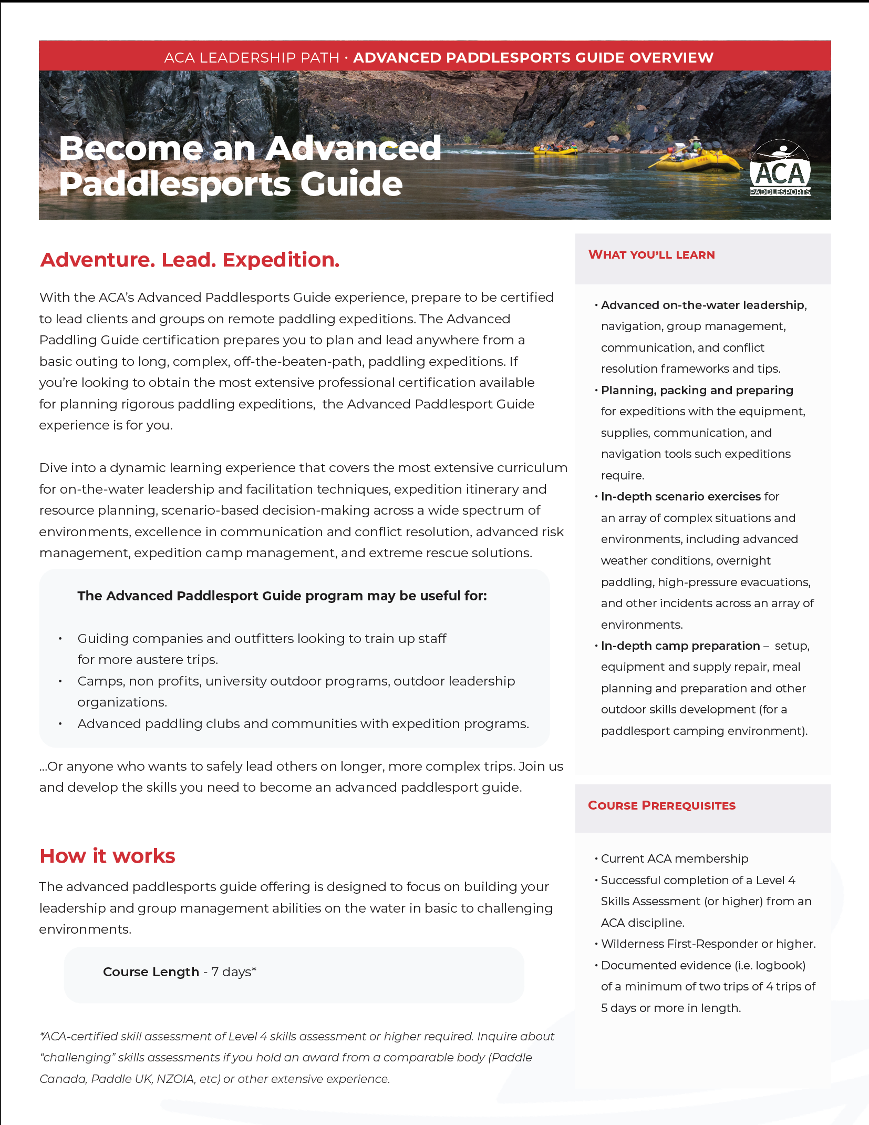
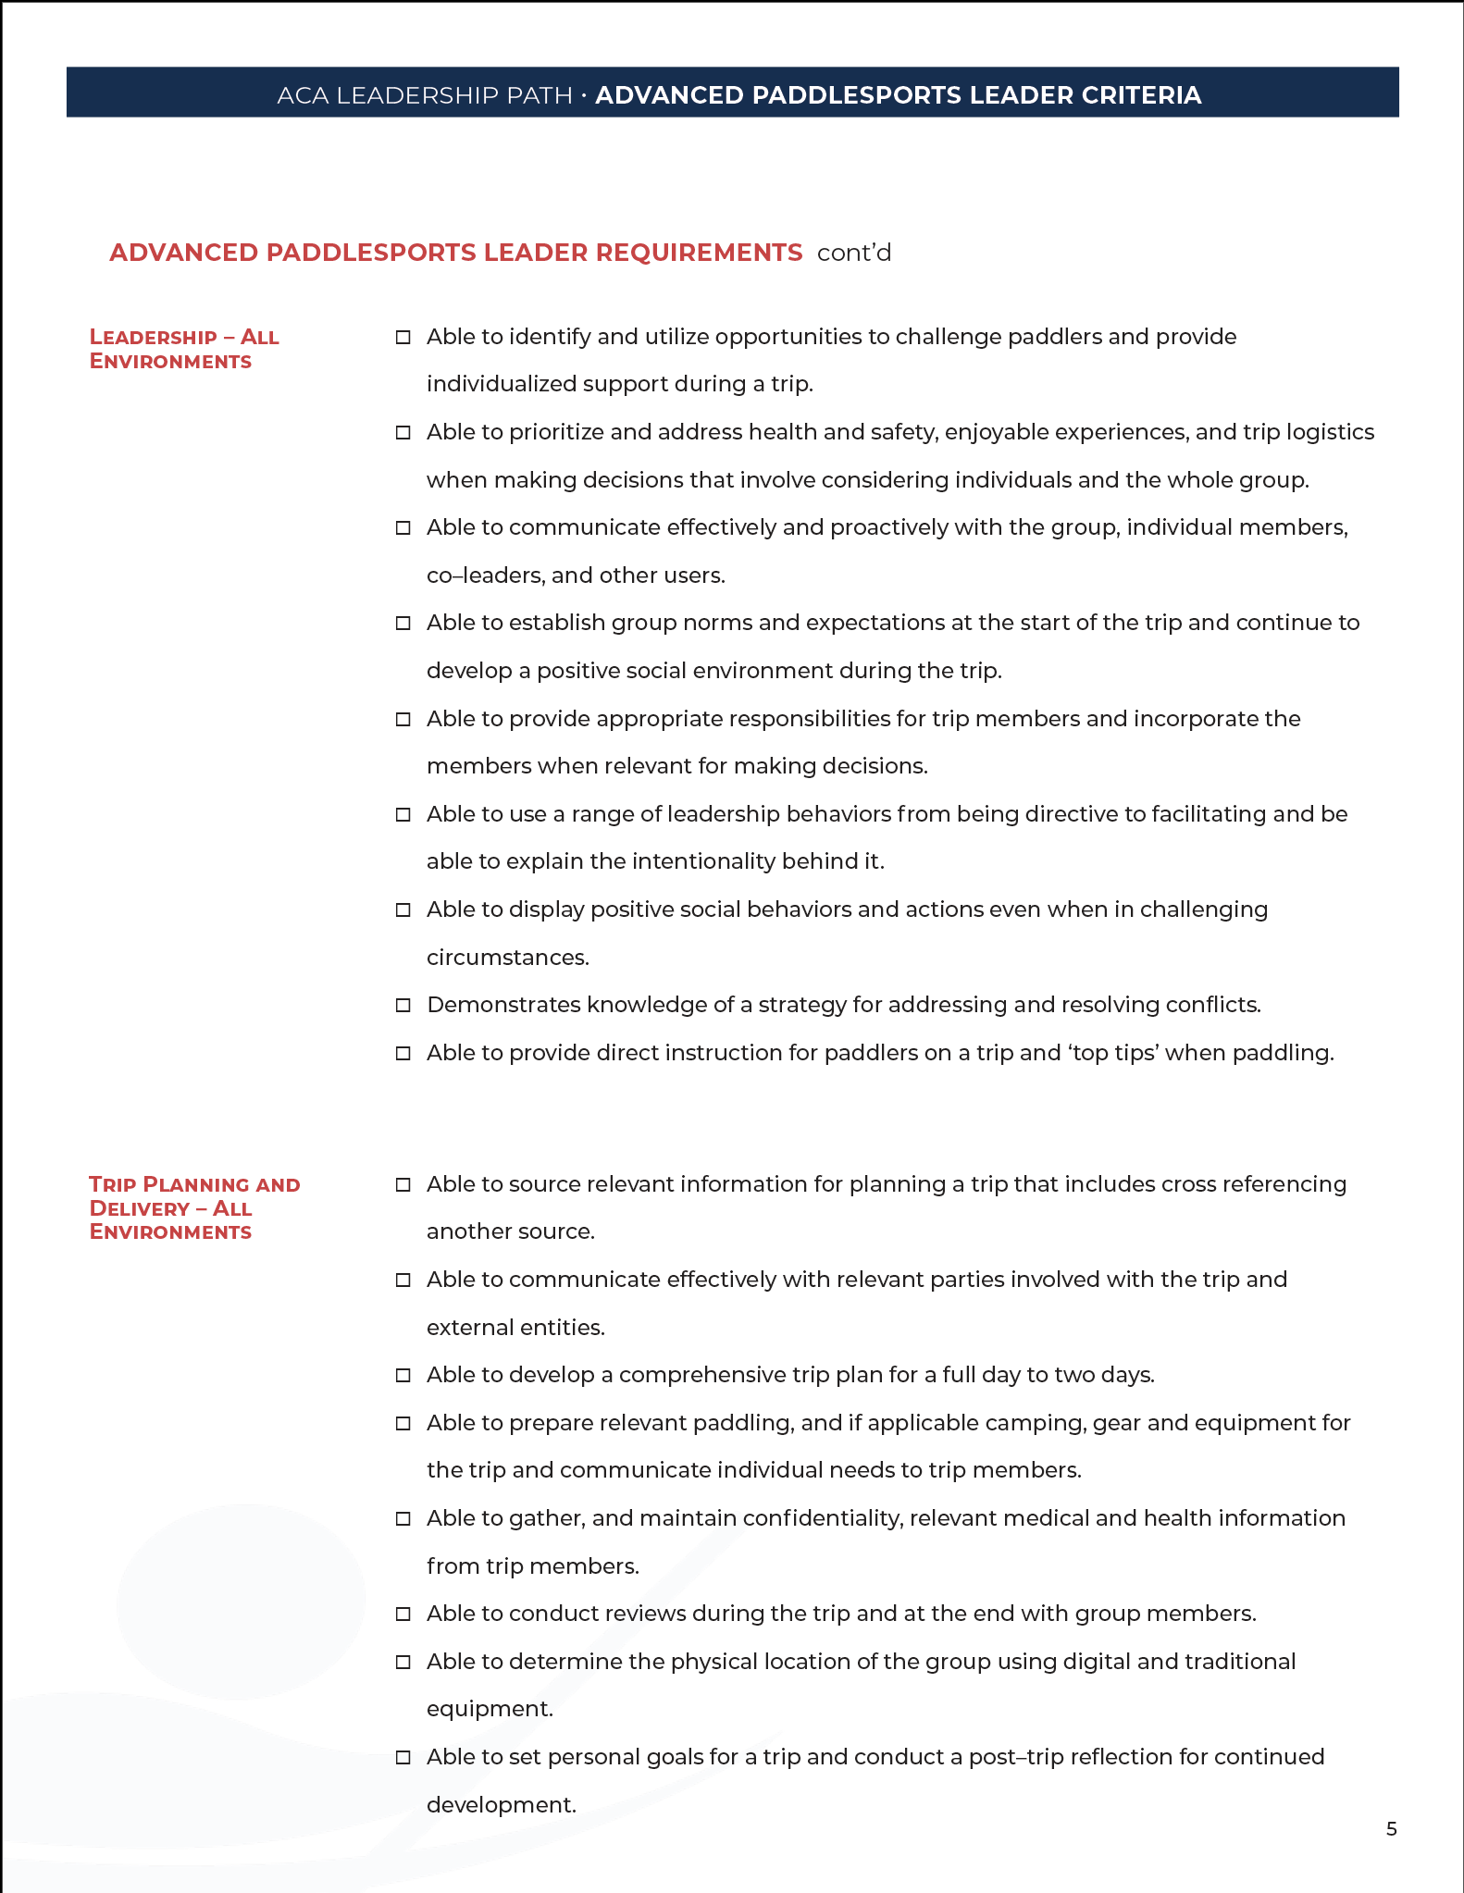
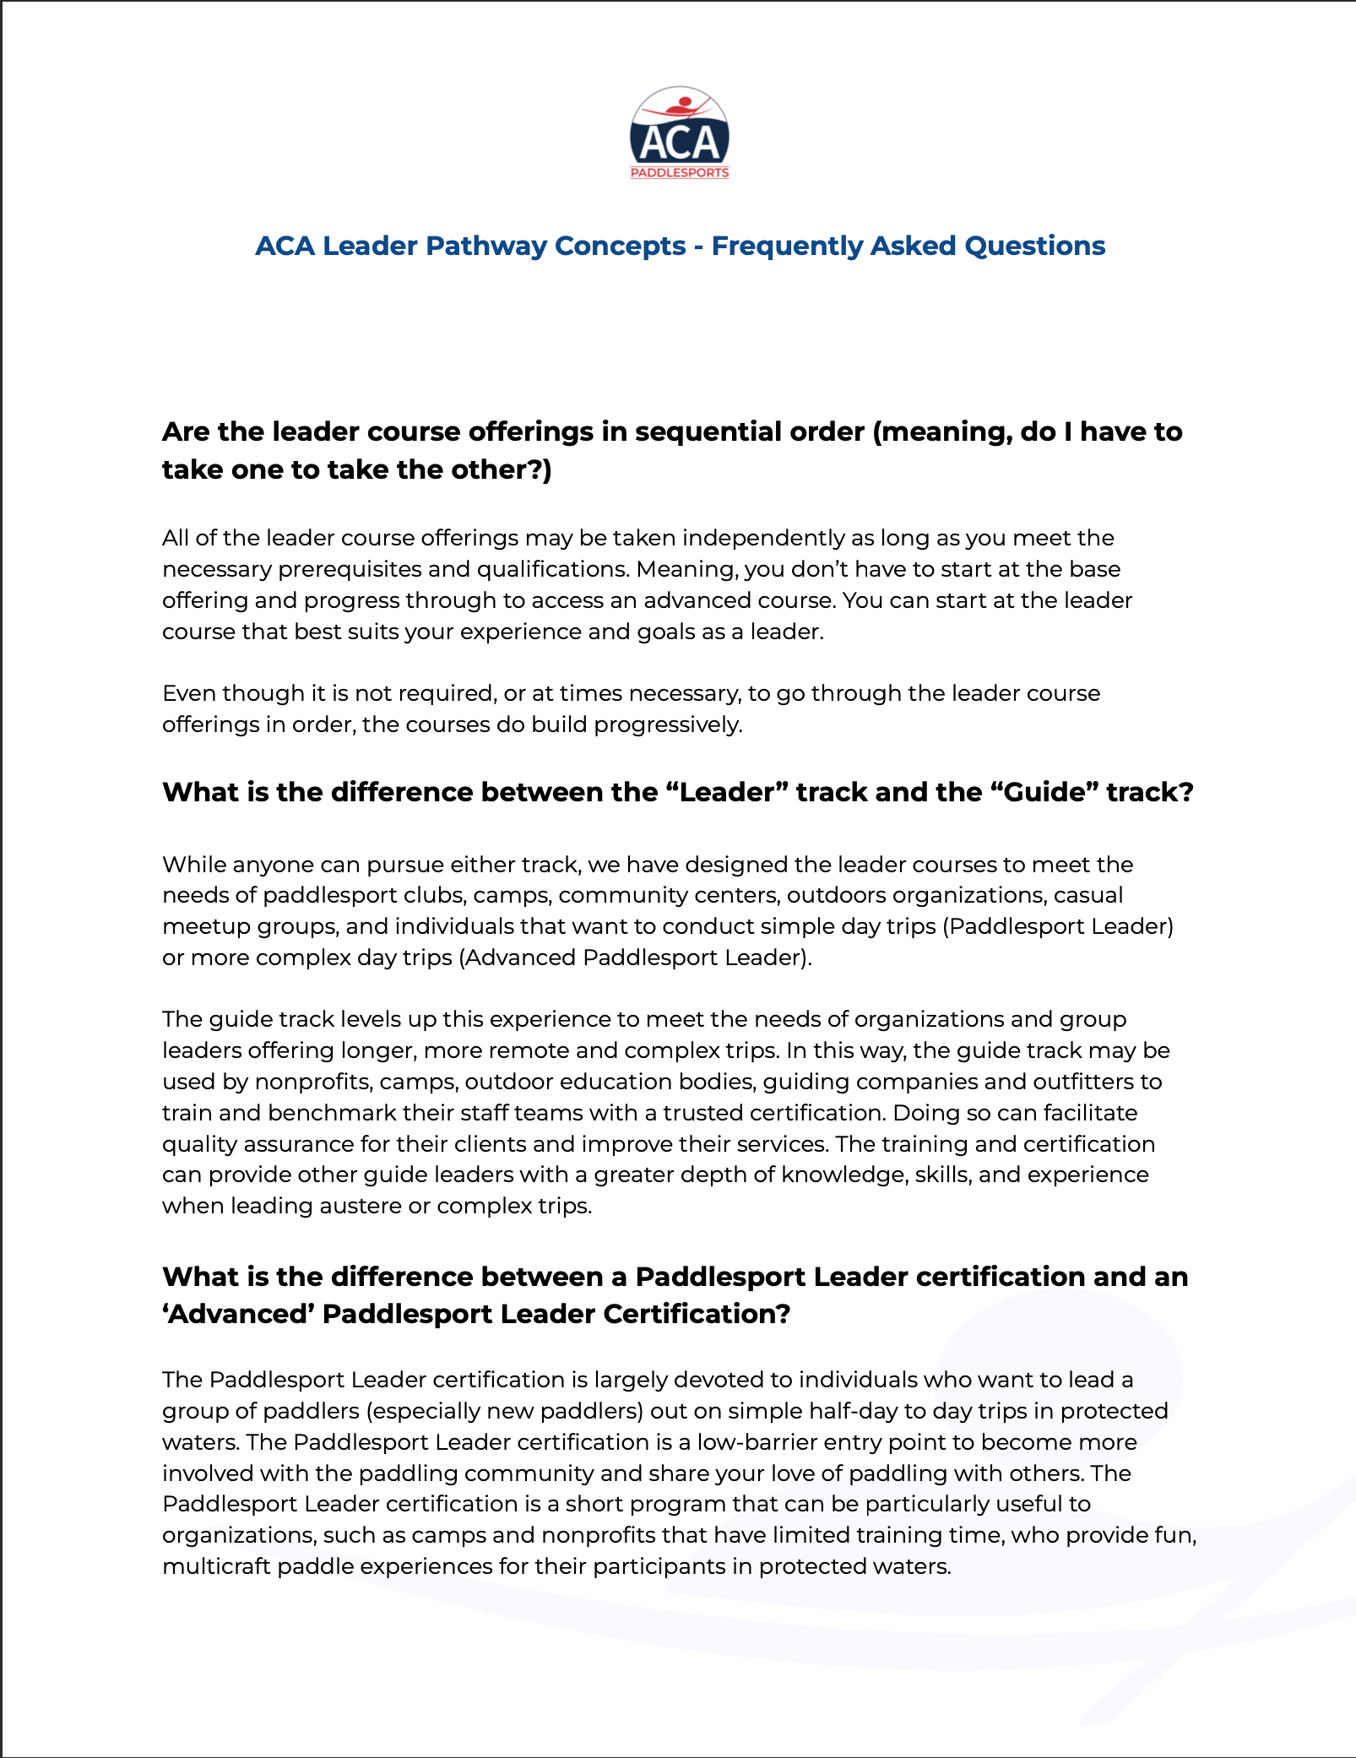
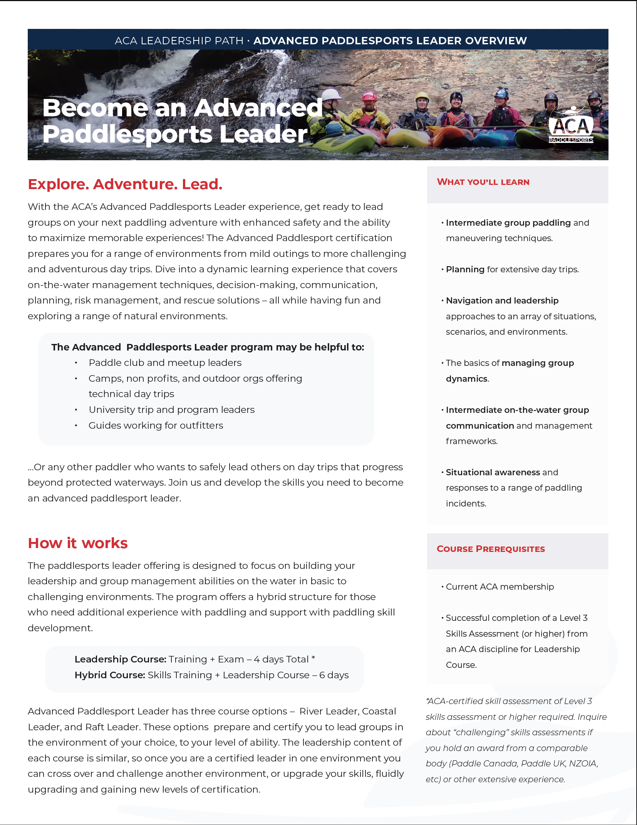
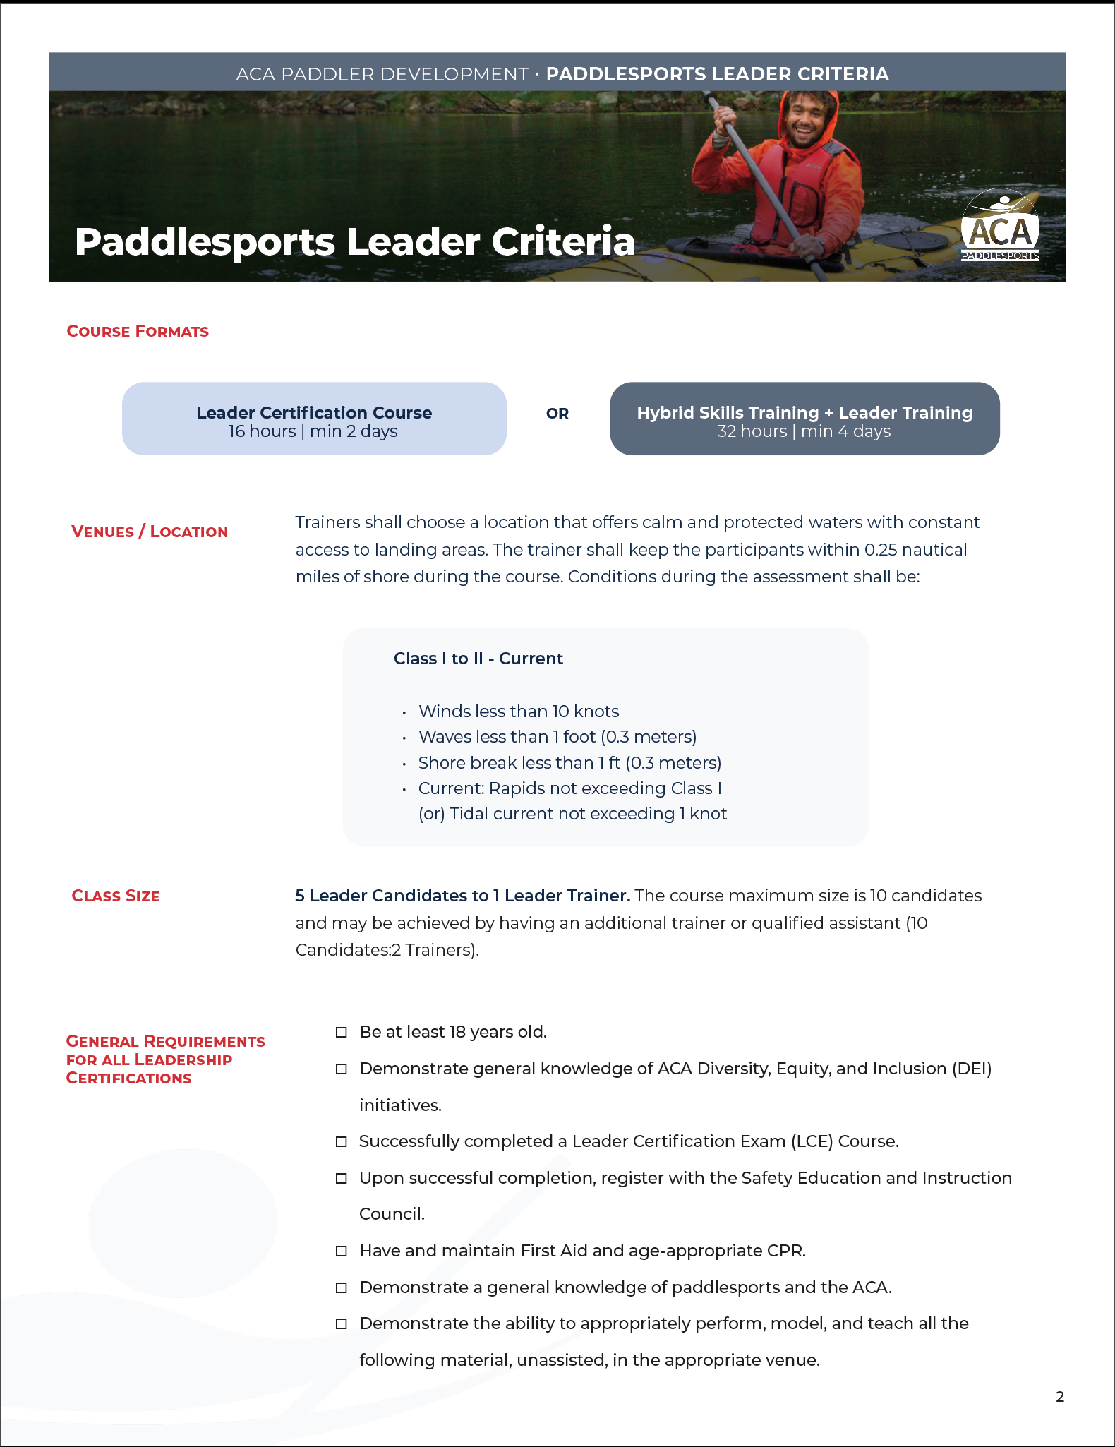
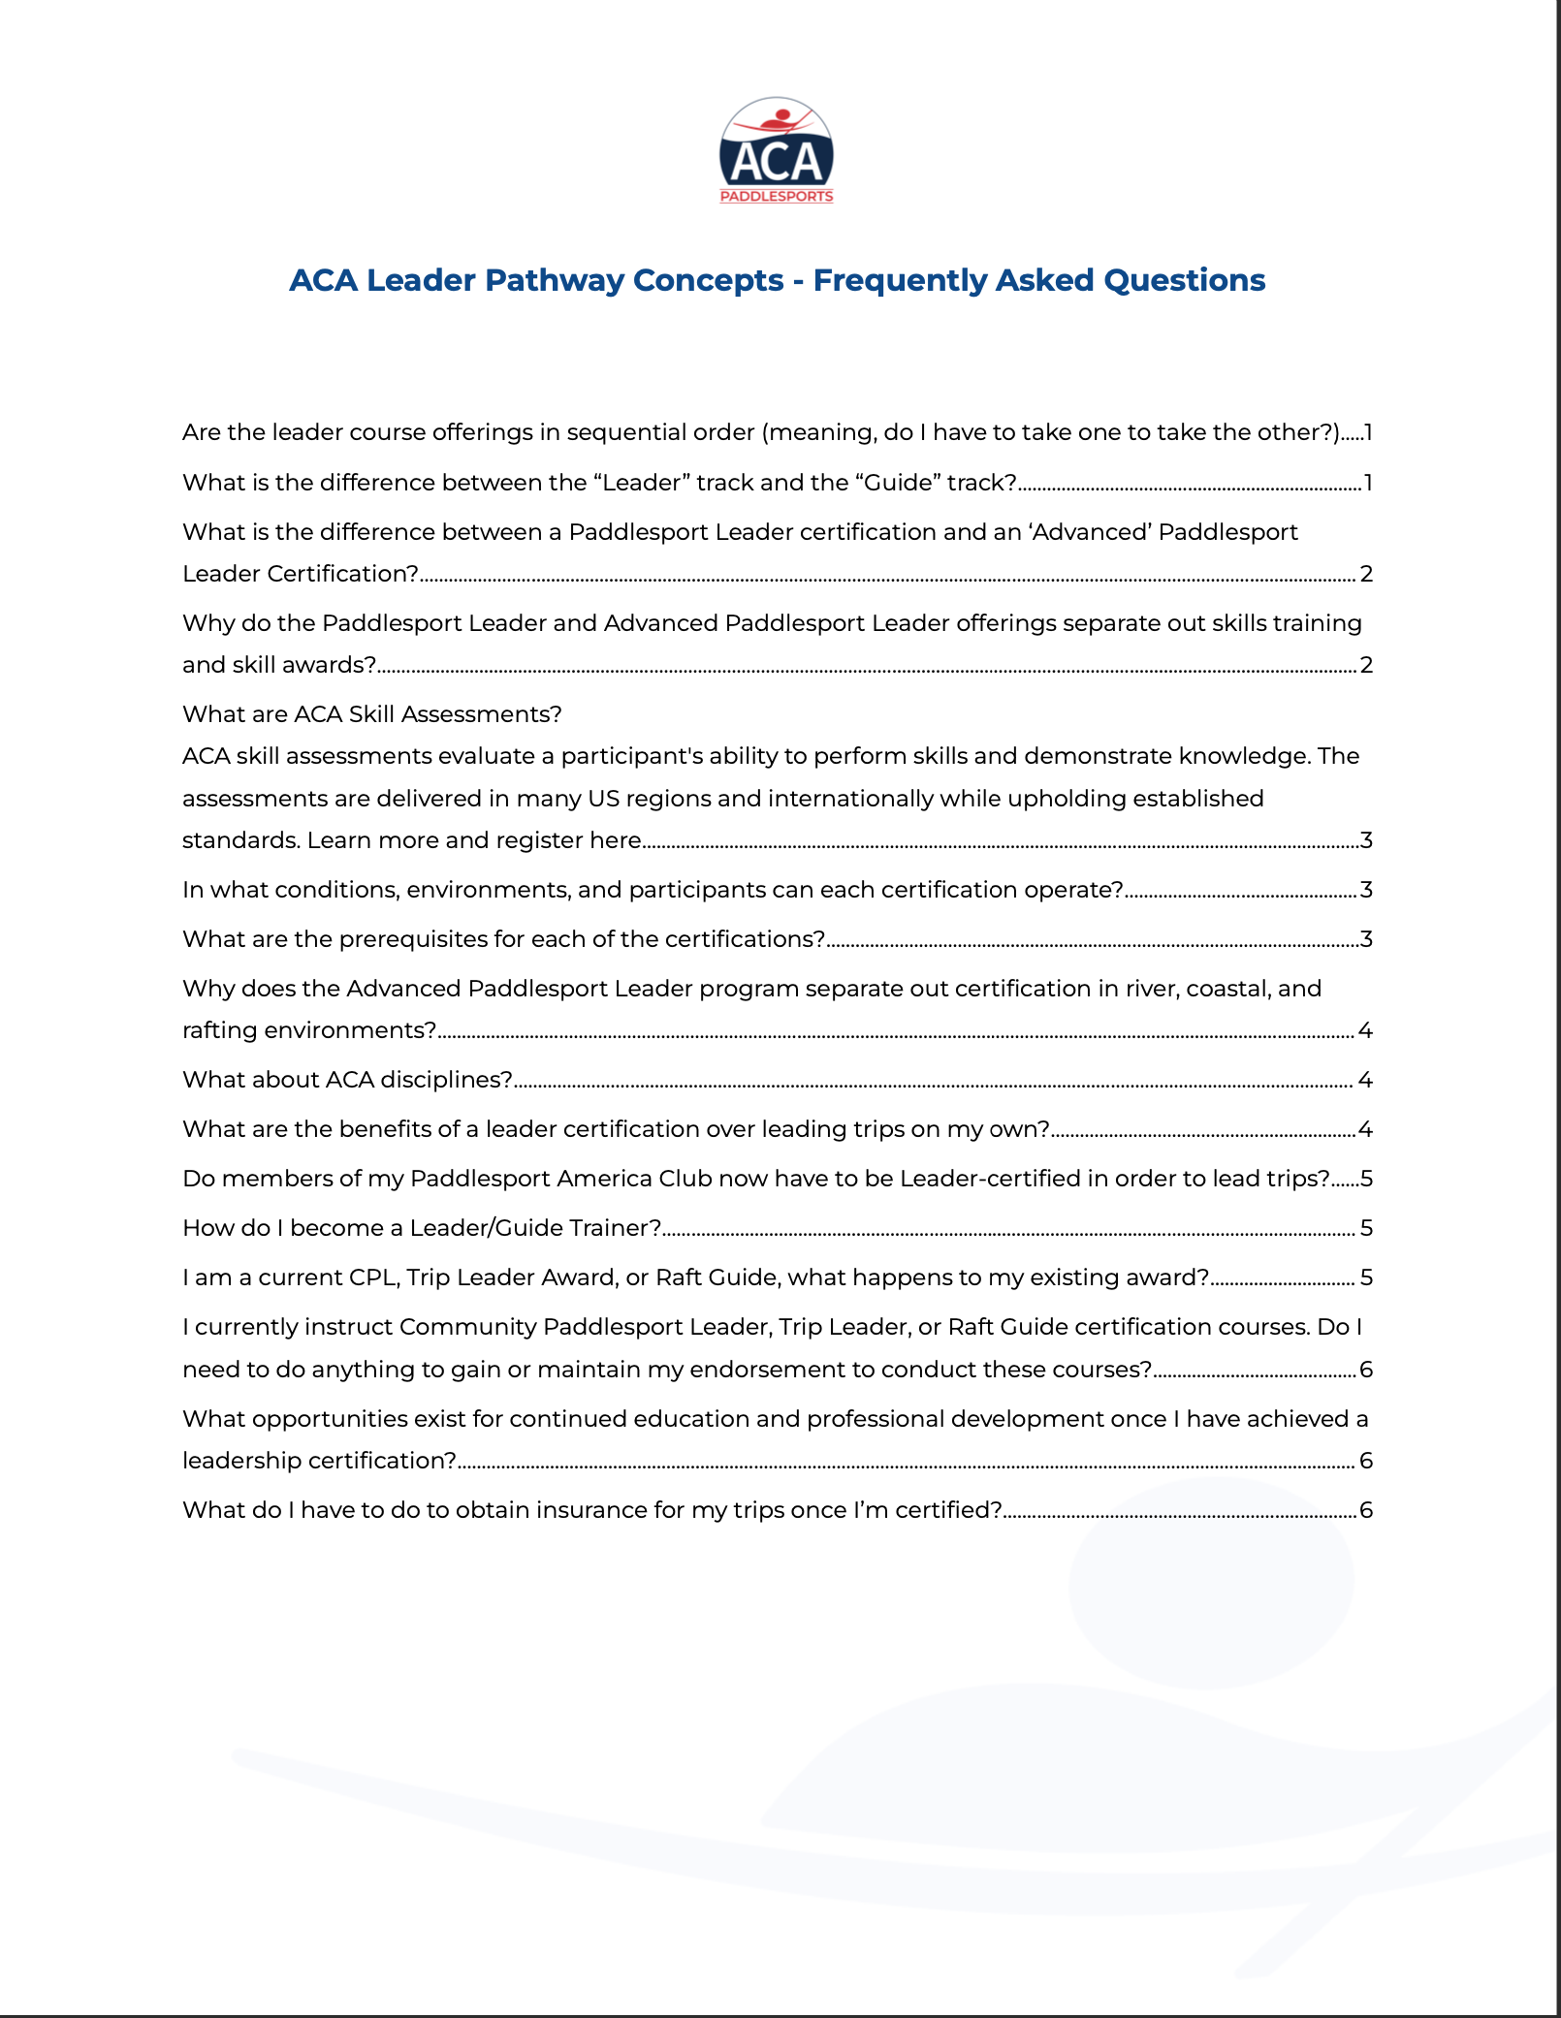
Available Online
Leadership Overviews
High level marketing overviews that present the value of the offerings from the prospective leader vantage point.
Leadership Criteria Docs
Assists in seeing a high level of what is taught, requirements, and other mechanics of the program for both leaders and instructors.
FAQ
Initial direction on key questions + more in depth topics pertaining to the offerings.

Slide 25

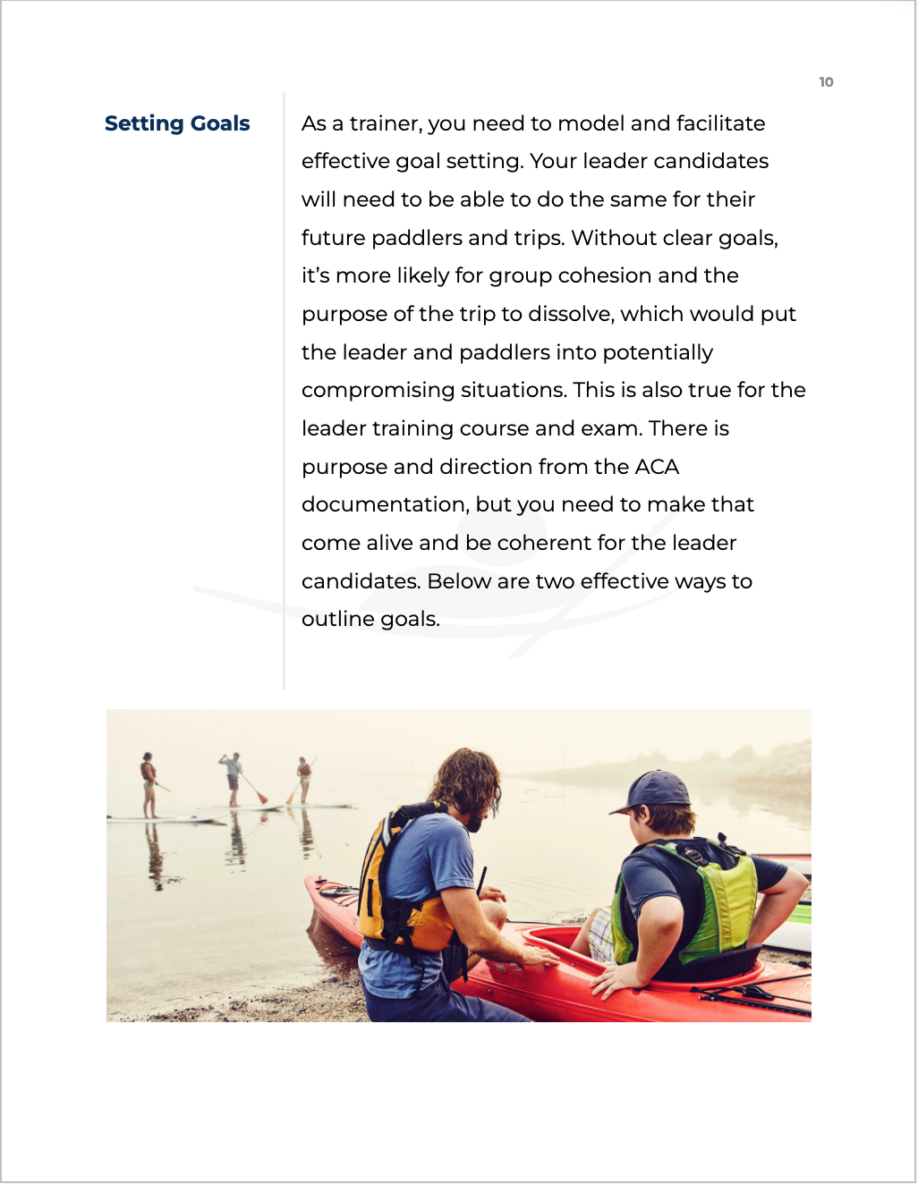
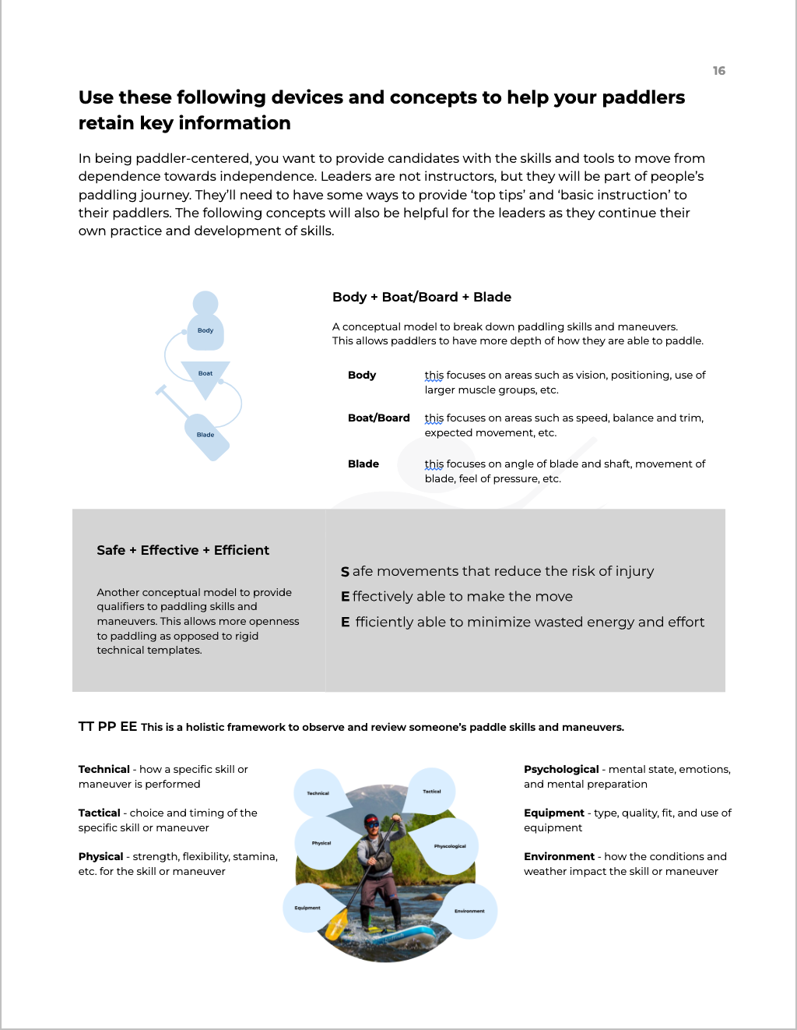
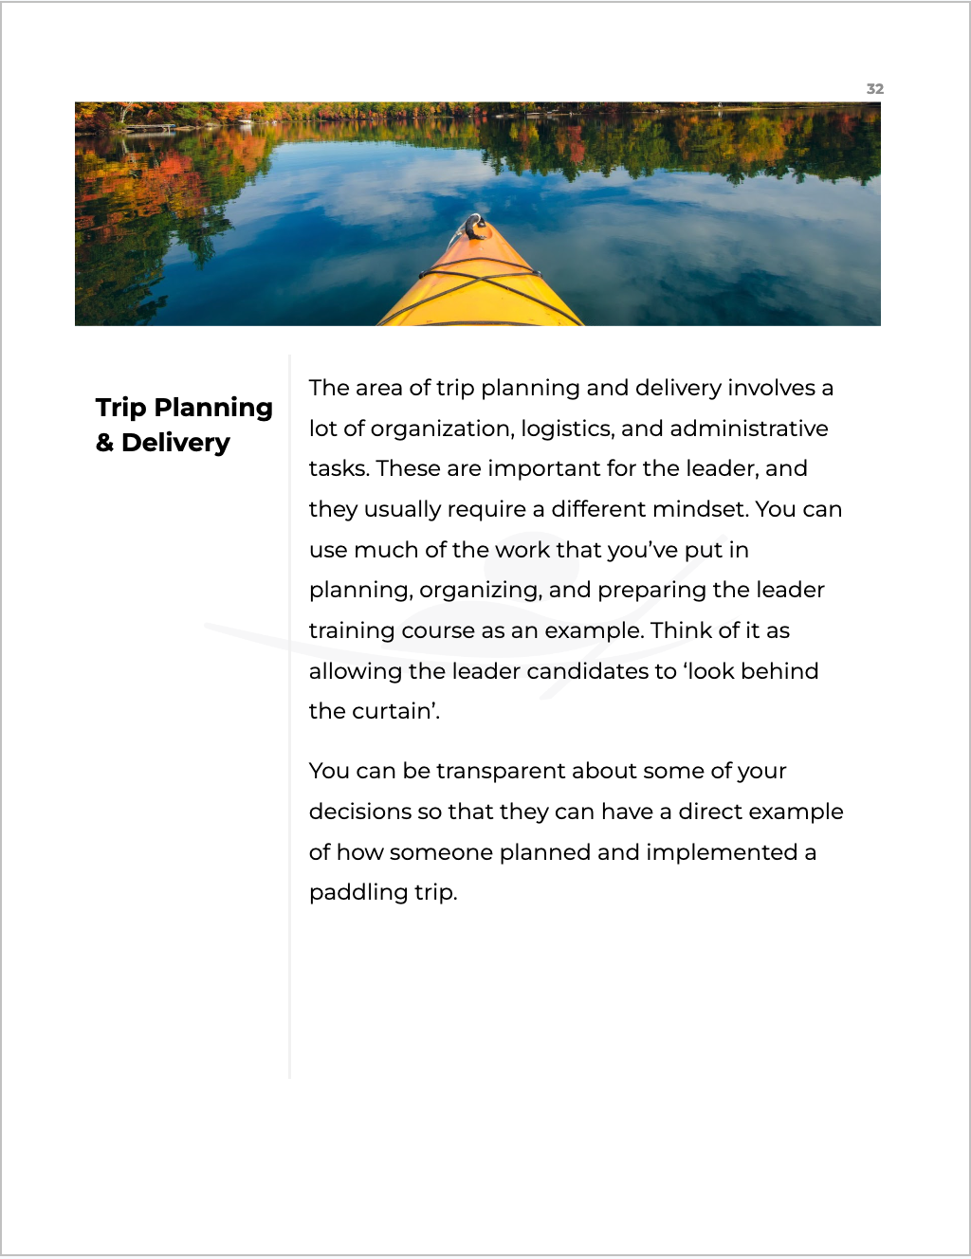
Print On Demand
Available May 15th, 2025
Trainer Workbooks
Full curriculum overviews that provide trainers with content they can use to train leaders, including:
Learning methods.
Leadership, communication and decision-making models.
Considerations for personal paddling skills.
Trip planning approaches and tips.
Trip management approaches.
Topical modules (safety and rescue, equipment, weather/environment, navigation, etc)

Slide 26
Print On Demand
Available May 15th, 2025
Trainer Resource Packets
Written Exams
Oral Exams
Case Studies
Scenarios
Optional Templates
  Trip Planning
  Supplemental Materials (CLAP, equipment lists, river safety information)

Slide 27

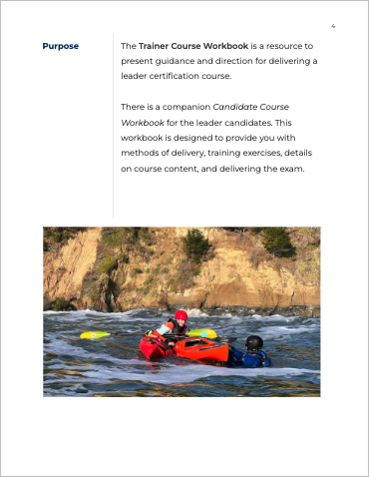
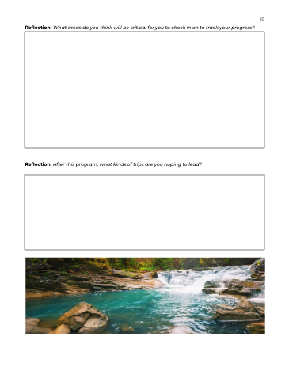
Print On Demand
Available May 15th, 2025
Candidate Course Workbooks
Candidate facing workbook with supporting content to review and reflect as they experience their program (50+ pages):
Learning methods.
Leadership, communication and decision-making models.
Considerations for personal paddling skills.
Trip planning approaches and tips.
Trip management approaches.
Topical modules (safety and rescue, navigation, equipment, weather/environment, etc).

Slide 28
  What challenges/opportunities do you foresee with having a multi-craft component?
  What challenges/opportunities do you foresee with having leader candidates with varied experience?
    How do you adjust the content/flow/exercises?
    What strategies do you have when preparing and delivering courses in new/different locations?
BREAK-OUT ROOMS 1
Notes:
After breakout room, place key points into whole Zoom chat. Then people can ‘thumbs up’ points that they agree with.

Slide 29
  What opportunities do you see for yourself in the Leader Pathway?
    How can the Leader Pathway benefit your paddling community?
    What support do you have / may you need to help with these new courses?
BREAK-OUT ROOMS 2
Notes:
After breakout room, place key points into whole Zoom chat. Then people can ‘thumbs up’ points that they agree with.

Slide 30
Next

Slide 31
  Participation Recorded
  Complete this process - submit your reflection form.
  Memo on Ordering Course Resources
  CMS Tutorial
  Print On Demand Materials Available May 15th, 2025 (info to be sent)
  Courses Active May 15th, 2025
  Leader Pathway Forum (June)
  ACA Conference (October)
  Hybrid Format (Jan 2026)
Next Steps
Notes:
After breakout room, place key points into whole Zoom chat. Then people can ‘thumbs up’ points that they agree with.

Slide 32
Implementation Plan - Future Onboarding
 | Wave 1 | Wave 2 | Wave 3 | Wave 4
Time Period | January - March | May Onward | June Onward | Future
Audience | Audience: First wave of current ITs, ITEs. | ITs and ITEs that weren’t able to attend onboarding session. | Existing trip leader evaluators/ assessors/ examiners. | Instructors that want to become Trip Leader trainers.
Trainers | Anna, Trey Rouss, Ryan Rushton, Jake Taylor | LTs and LTEs who went through 1st Wave onboarding. | Folks who undertook 1st or second wave trainer onboarding. | Individuals who were onboarded during waves 1-3

Slide 33
Thank You

